Slide 1
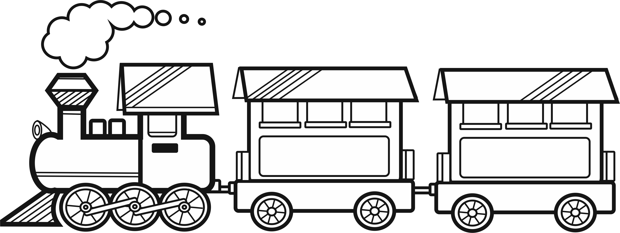

Let’s get on the reading train!
americanenglish.state.gov

Slide 2
Book Title:
Your Name:
Main characters:
Setting:
This book was about (2-3 sentences):
One thing I liked about this book (1-2 sentences):
americanenglish.state.gov

