Slide 1
Gonna, Wanna, Gimme More: Teaching Listening and Pronunciation through American Music
Music is one of the most powerful and engaging tools for teaching listening and pronunciation. This session highlights how popular American songs can help learners notice and practice key features of natural speech, including contractions, reductions, and rhythm.
Together, we will examine short, classroom-ready song excerpts that feature authentic American English speech and discover simple listening and pronunciation activities suitable for a wide range of contexts.
By the end of the webinar, participants will have a toolkit of practical strategies and adaptable ideas for using music to build learners’ listening comprehension and pronunciation skills across levels.

Slide 2

Tiffany Lao
Tiffany is an ESL professor at Irvine Valley College and Golden West College, with extensive experience teaching academic writing, pronunciation, and conversation courses. She recently served as a Virtual English Language Educator with the U.S. Department of State, designing and delivering medical English courses for nursing students in Pakistan.
Tiffany specializes in innovative approaches to engaging multilingual learners. She has previously taught at various colleges and universities in the United States and internationally through the Japan Exchange and Teaching (JET) Program. She has also worked as a Skill Architect for Duolingo to develop CEFR-aligned content for English learners, authored multiple ESL textbooks, and presented at regional and international conferences.

Slide 3
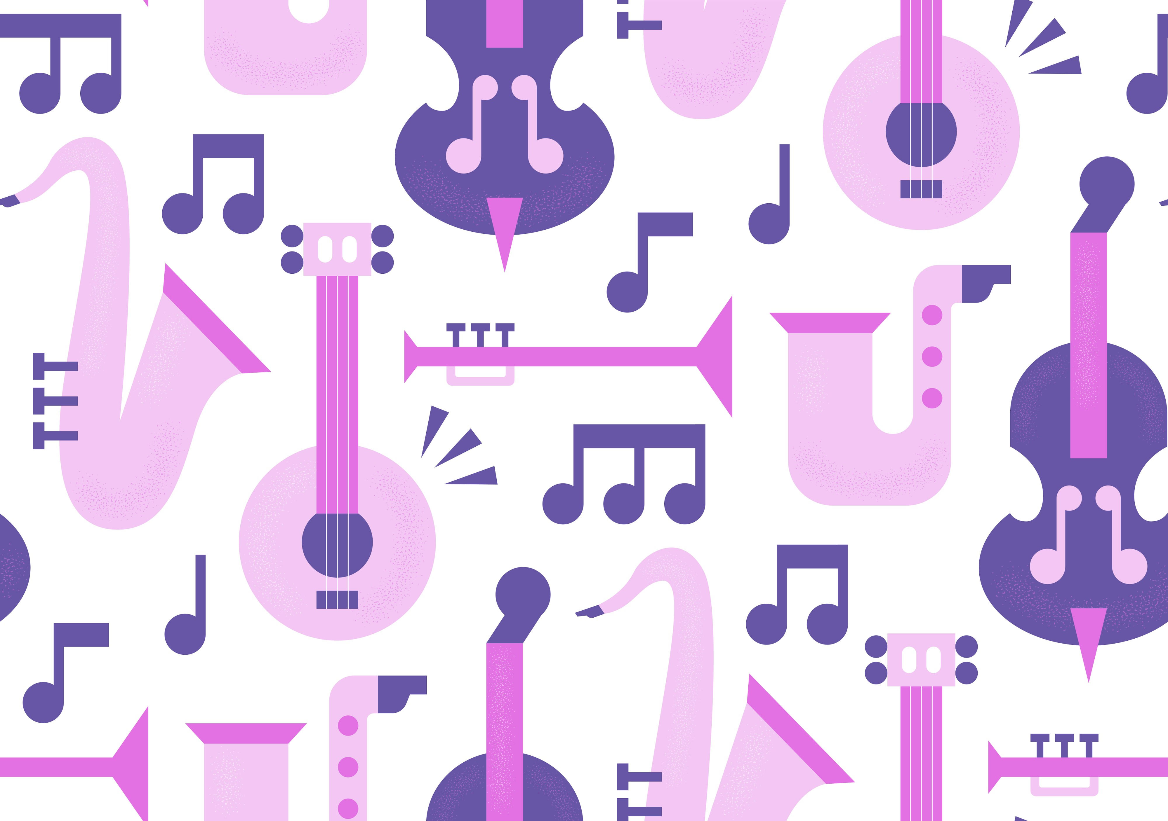

Gonna, Wanna, Gimme More: Teaching Listening and Pronunciation through American Music
© 2026 by Tiffany Lao. Gonna, Wanna, Gimme More: Teaching Listening and Pronunciation through American Music for the American English Live Teacher Professional Development Series, sponsored by the U.S. Department of State with funding provided by the U.S. government and administered by FHI 360. This work is licensed under the Creative Commons Attribution 4.0 License, except where noted. To view a copy of the license, visit: http://creativecommons.org/licenses/by/4.0/

Slide 4
In This Session, We Will…
…identify common reduced forms found in authentic spoken English and music.
…explain how connected speech affects listening comprehension.
…design scaffolded listening tasks using American music.
Notes:
2022 by Adrienne Johnson. Planning for and Managing Small Group Instruction for the American English Live Teacher Professional Development Series, sponsored by the U.S. Department of State

Slide 5


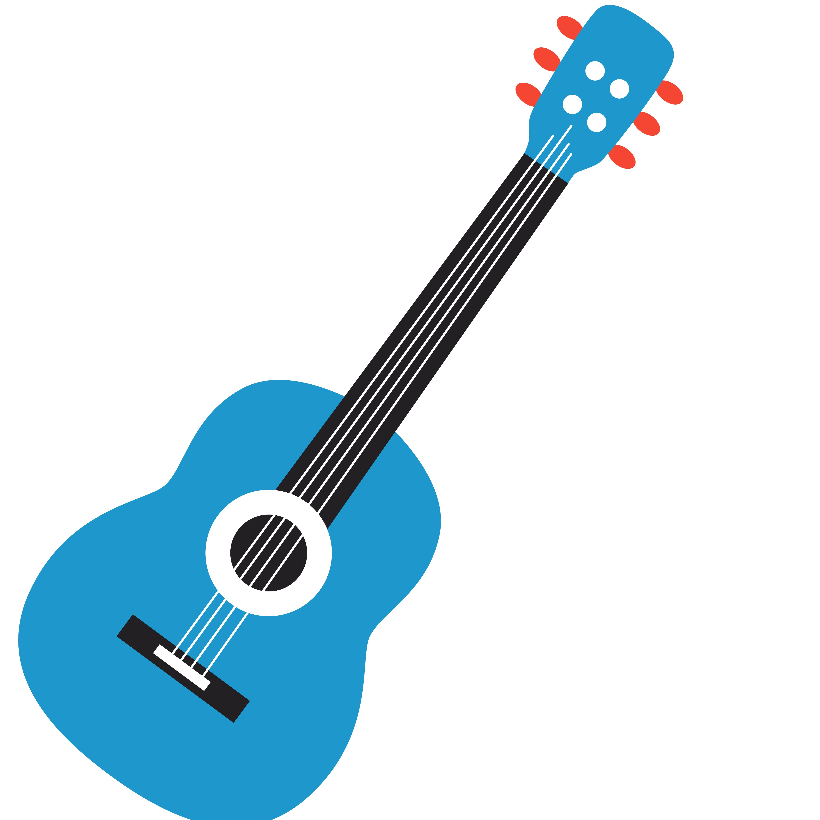
Your Turn!
How do you currently use music to support language learning in your English classes?
Feel free to share strategies, ideas, or even let us know if you don’t use music much yet.

Slide 6
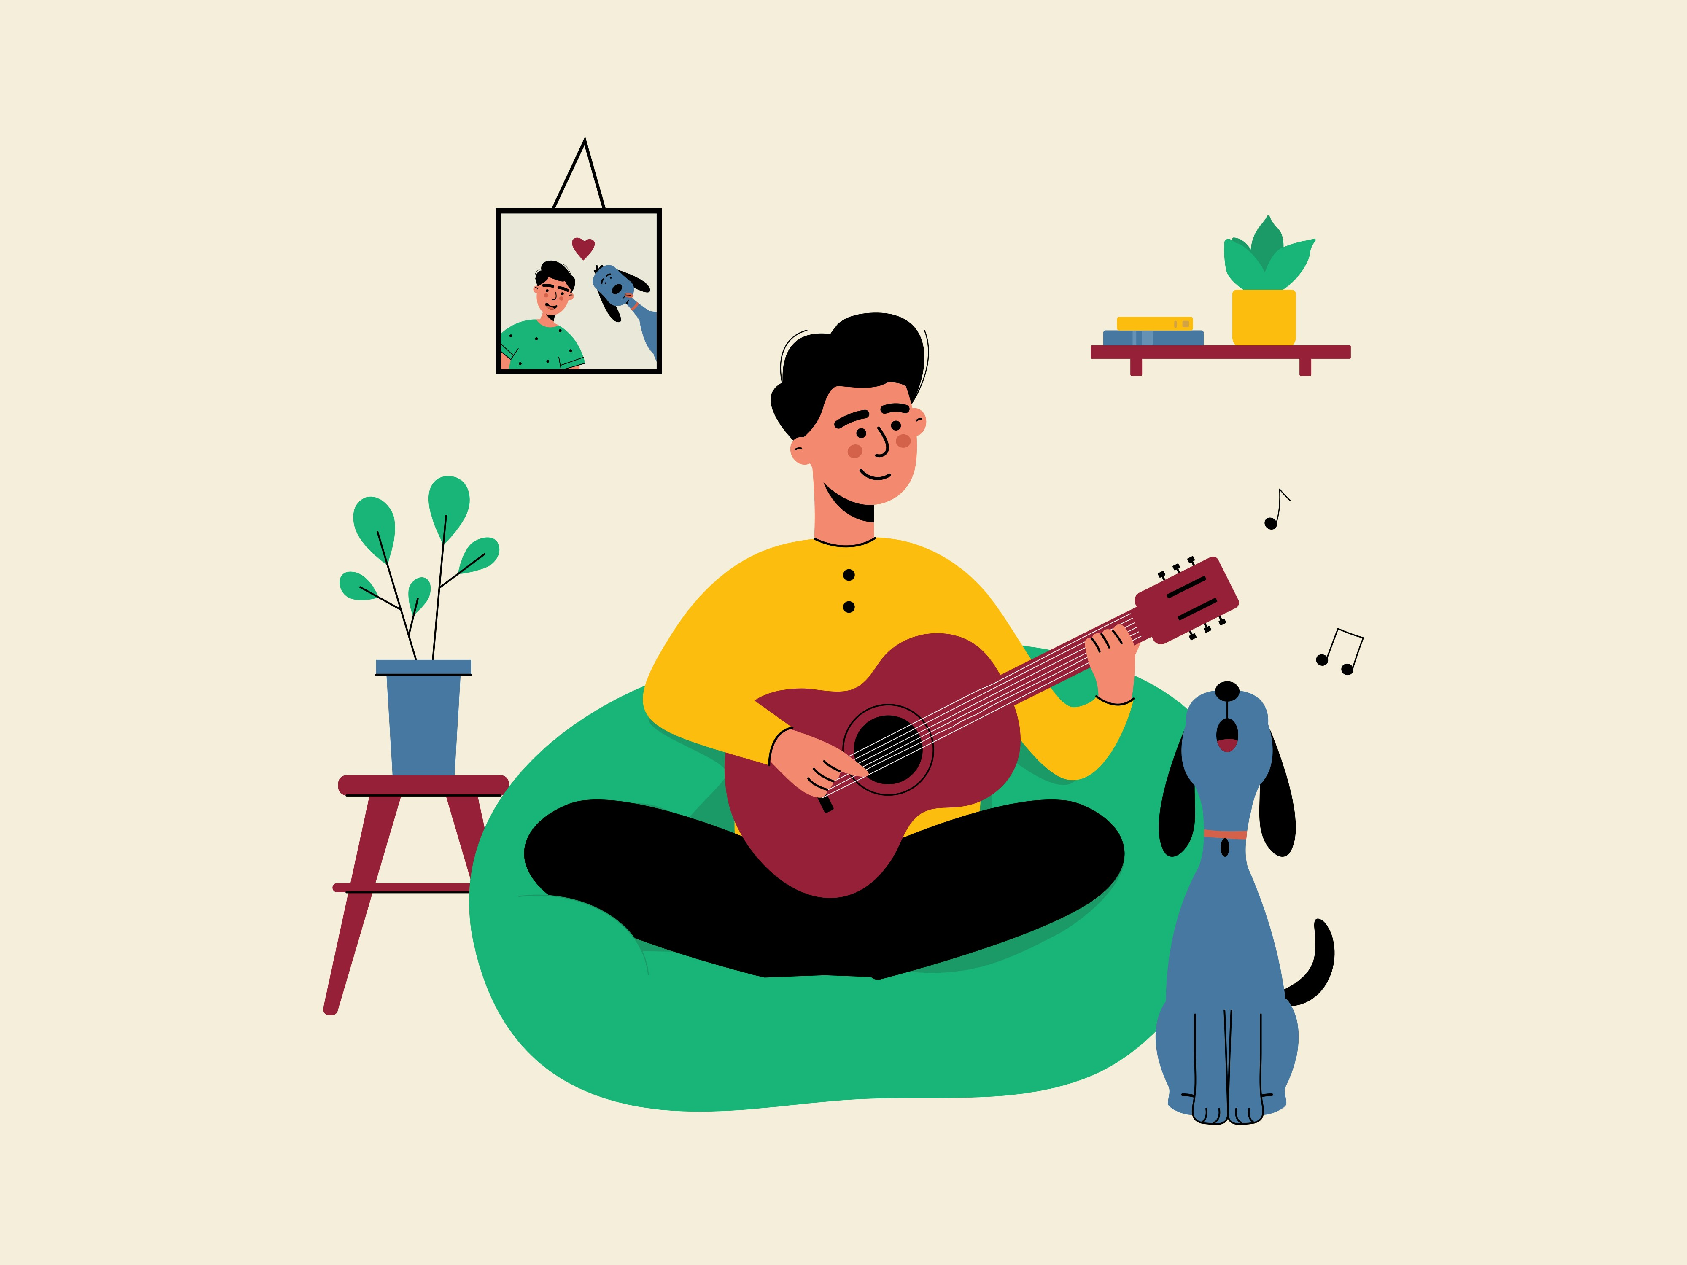
Why Music?
Students notice how real English sounds
Songs repeat patterns (helps memory)
Shows connected speech (wanna / didya / whaddya)
Improves listening confidence
Low prep + high engagement
Easy to adapt for all levels

Slide 7

Today’s Agenda
Part 1: Reduced forms in music
Part 2: Building Listening Tasks
Part 3: Rhythm and stress instruction
Part 4: Mini-lesson demonstration

Slide 8
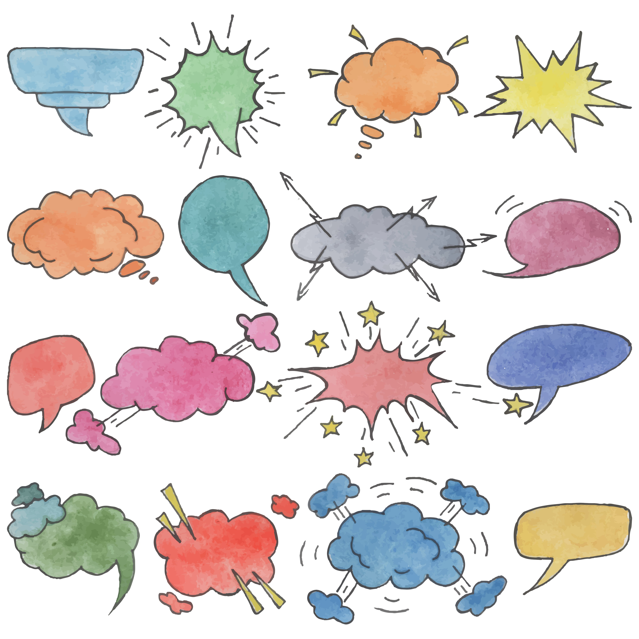
What is Connected Speech?
Reductions
Sounds become shorter/simpler in fast speech
Linking
going to → gonna
want to → wanna
let me → lemme
Final consonant links to next vowel sound
pick‿it‿up
see‿it
Contractions
Two words combine into one written + spoken form
I am → I’m
we are → we’re
they have → they’ve

Slide 9

Your Turn!
What challenges do your students face when listening to fast, connected speech in English?

Slide 10


English Language Through Lyrics
Wordplay is an exciting program between American English, U.S. Department of State, American Music Abroad, and American Voices to bring music and lyrics into the English Language classrooms across the world.
Sub Radio: What You Want to Hear
Tamara Jade: Better
Tony Memmel and His Band:
I Am Never, Never, Never Gonna Give Up
Jessica Lynn: Run To
https://americanenglish.state.gov/resources/english-language-through-lyrics

Slide 11
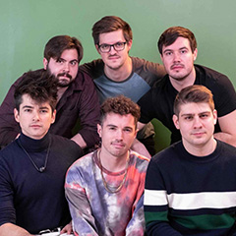


Sub Radio: What You Want to Hear
Long night, caught up in the details
Texts, calls, and emails from my broken friends
Long time since I thought I could fix them
Now everything is mixed up, man it never ends
Ooh, call up everyone I know and tell them
I love 'em and their problems
Hey, are we all as lonely as we say
Is a phone call all it takes?
Why don't you tell me what you want
Nine to five in a nightmare, we're not scared
We're bigger than the fear
Run away with me somewhere, anywhere
I'll tell you what you want to hear (repeated 3x)
(What you want, what you want, what you want)
Genre: Indie Pop, Pop
Level: Intermediate-Advanced
Focus: Reduced forms, Contractions

Slide 12
Sample Activity: Pronunciation Word Hunt
Student Instructions
1.Read the lyrics silently. DO NOT listen to the song yet.
2.Look for words or phrases that may sound different when sung.
3.Use the symbols below to mark the lyrics.
Pronunciation Symbols
🔵 Circle reduced forms (e.g., want to → wanna).
🔗 Underline linked words (words that connect together).
⭐ Star phrases that sound like one long word (did you go → didyougo)

Slide 13
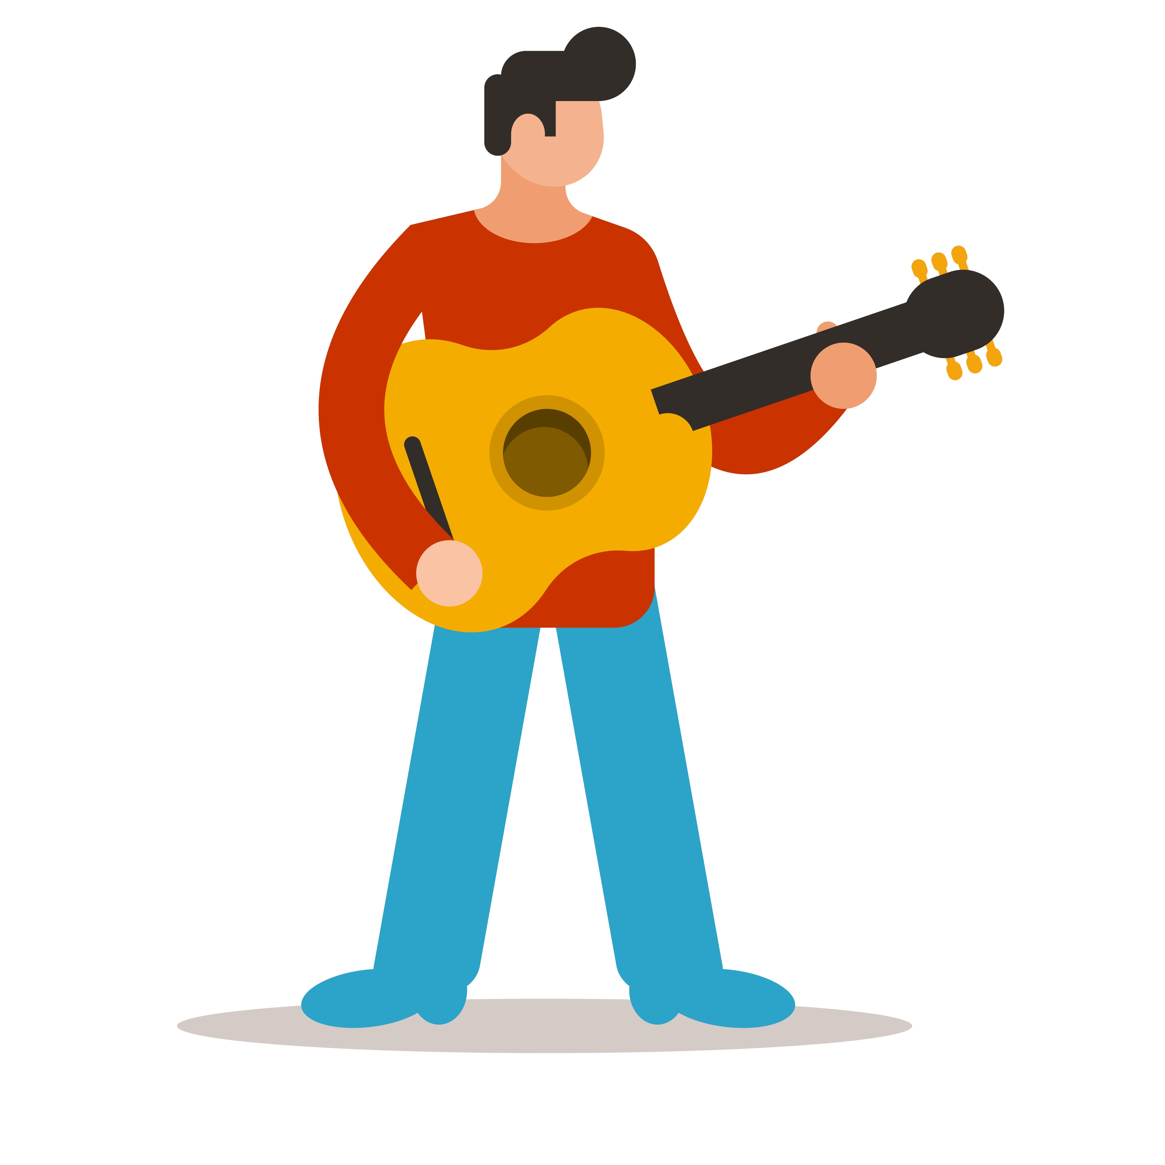

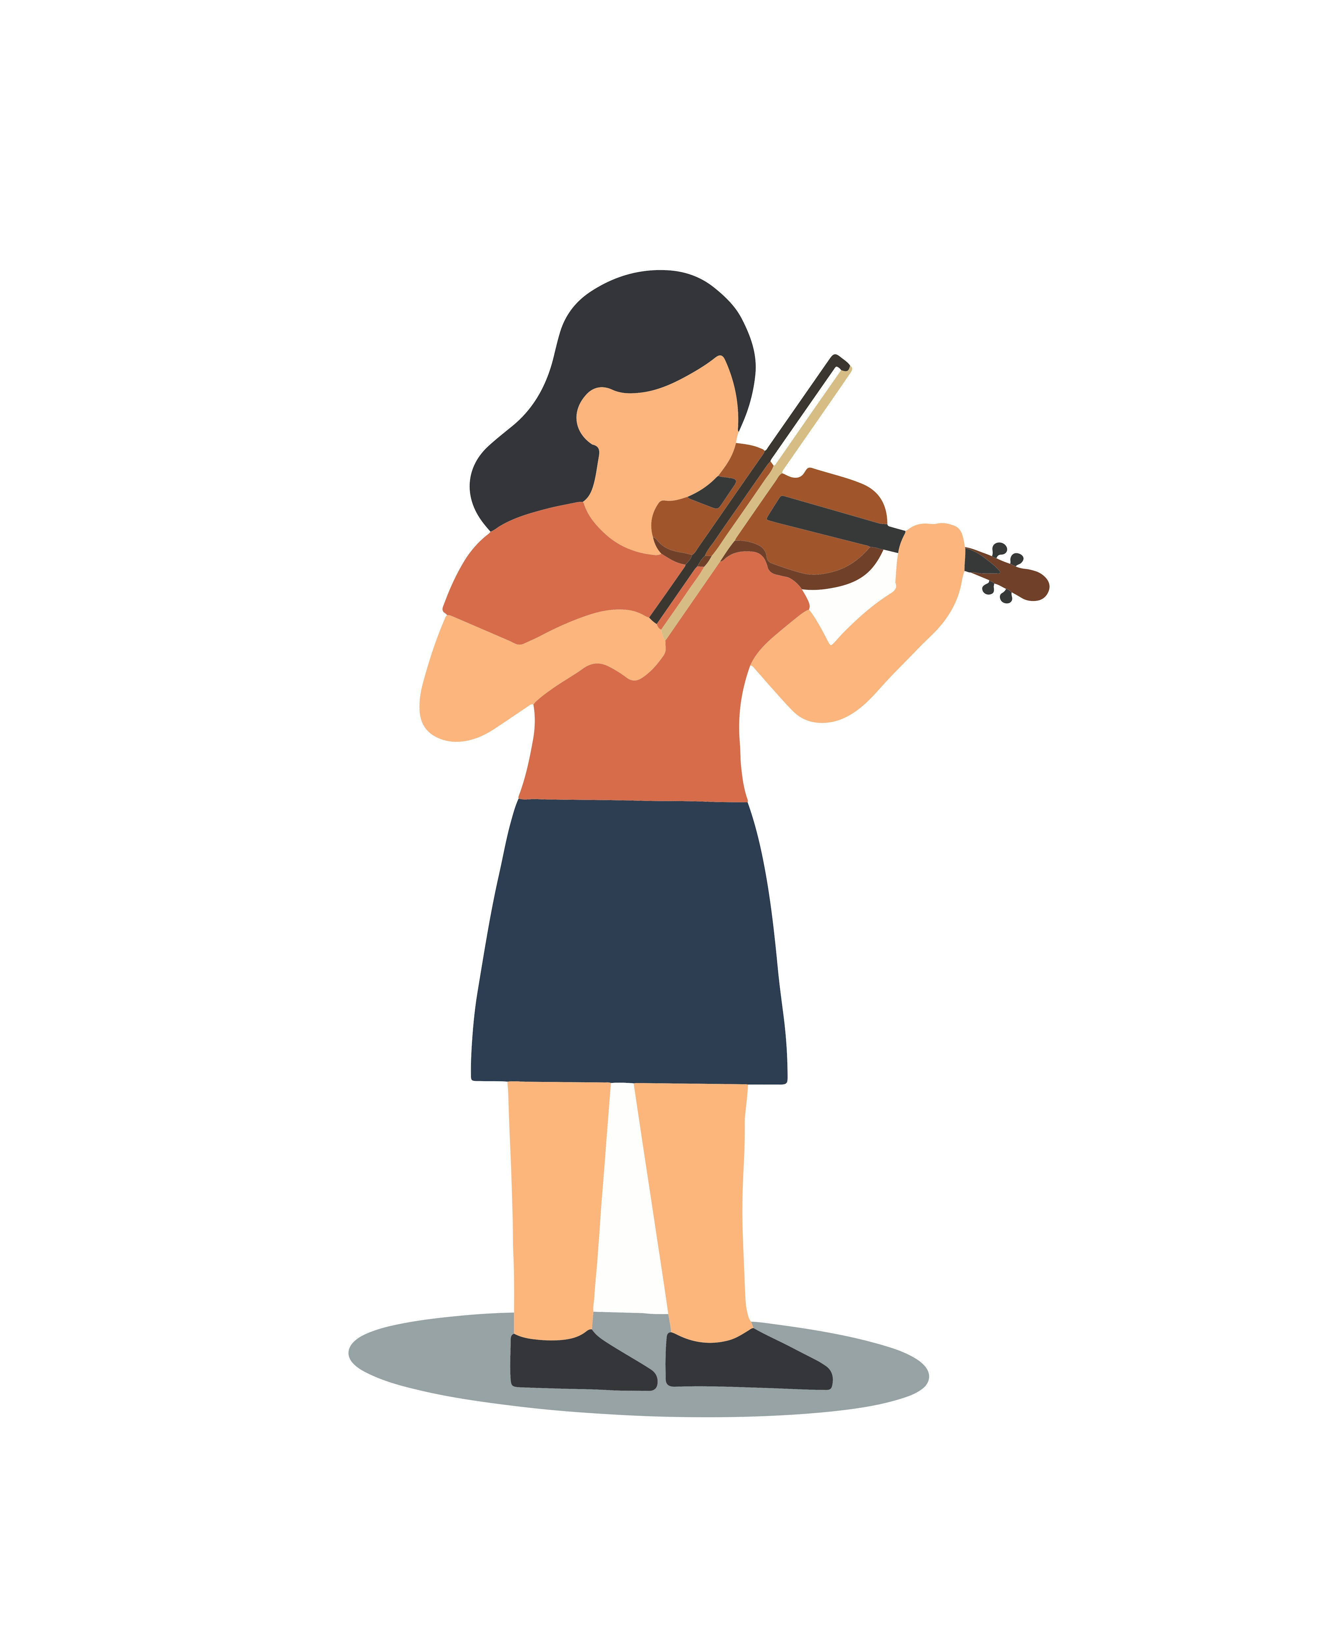
Sub Radio: What You Want to Hear Lyrics
⭐
Why don't you tell me what you want
Nine to five in a nightmare, we're not scared
Student samples
Why don't you tell me what you want
Nine to five in a nightmare, we're not scared
⭐

Slide 14
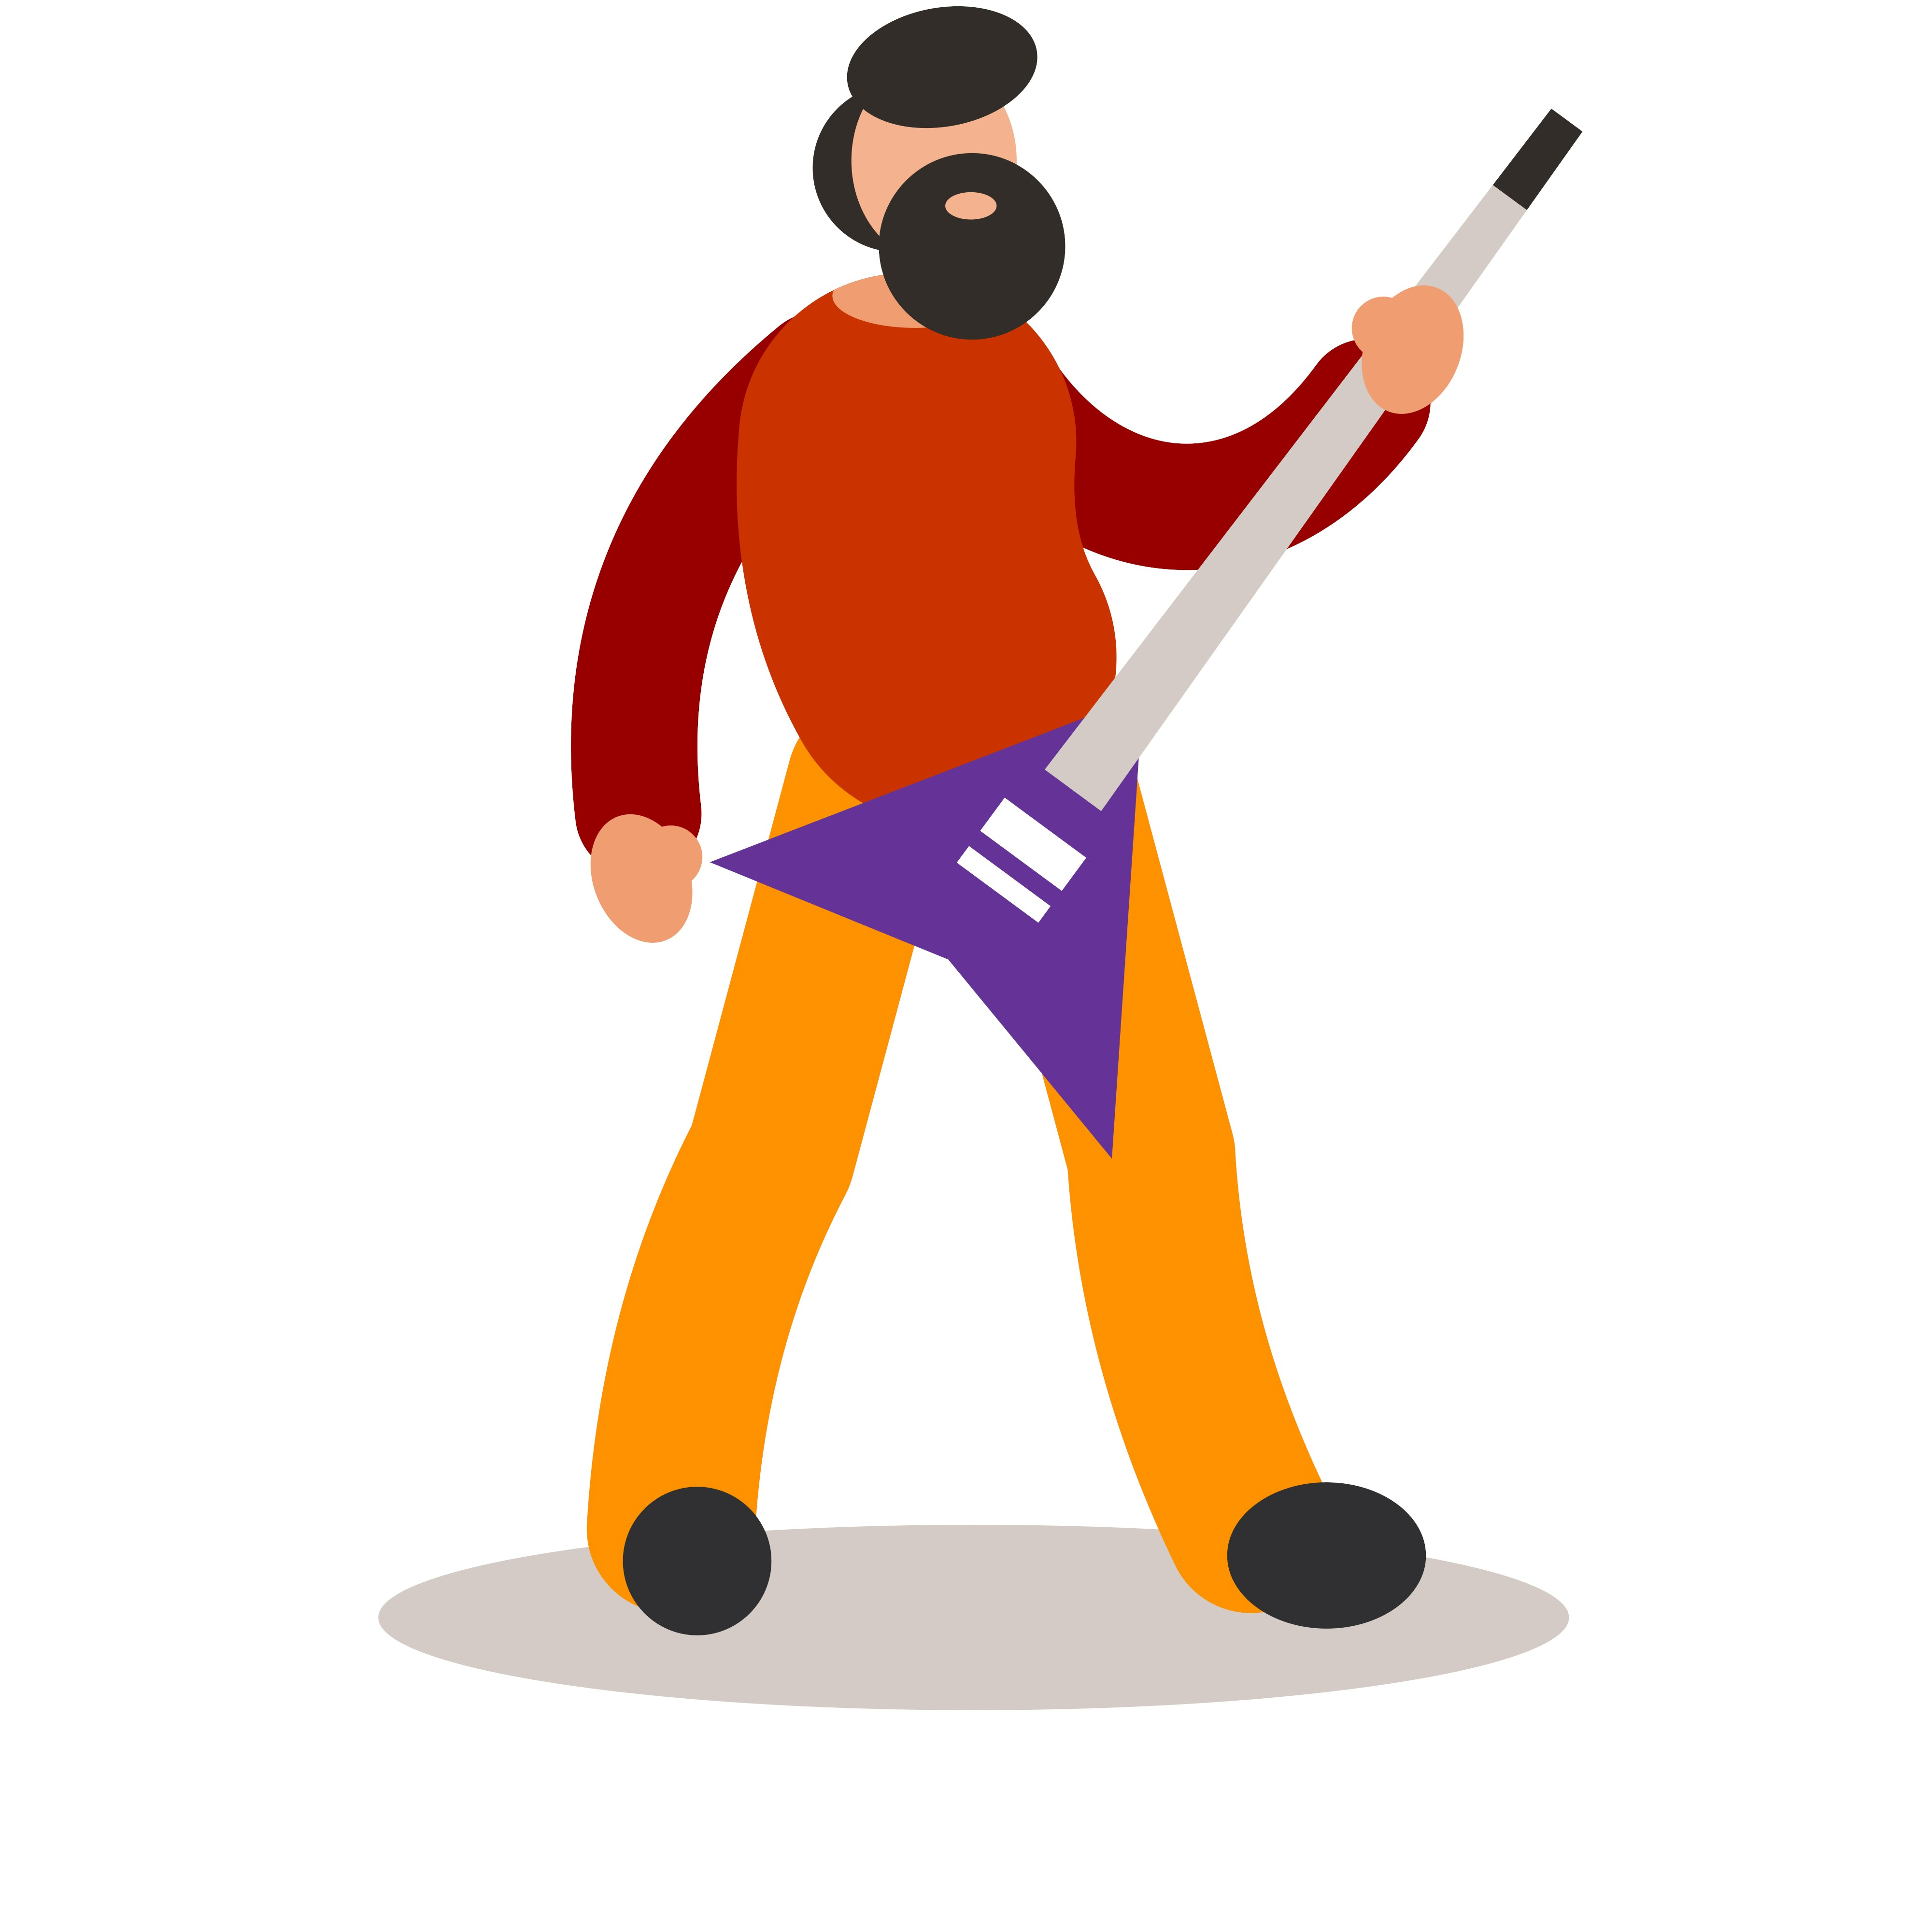
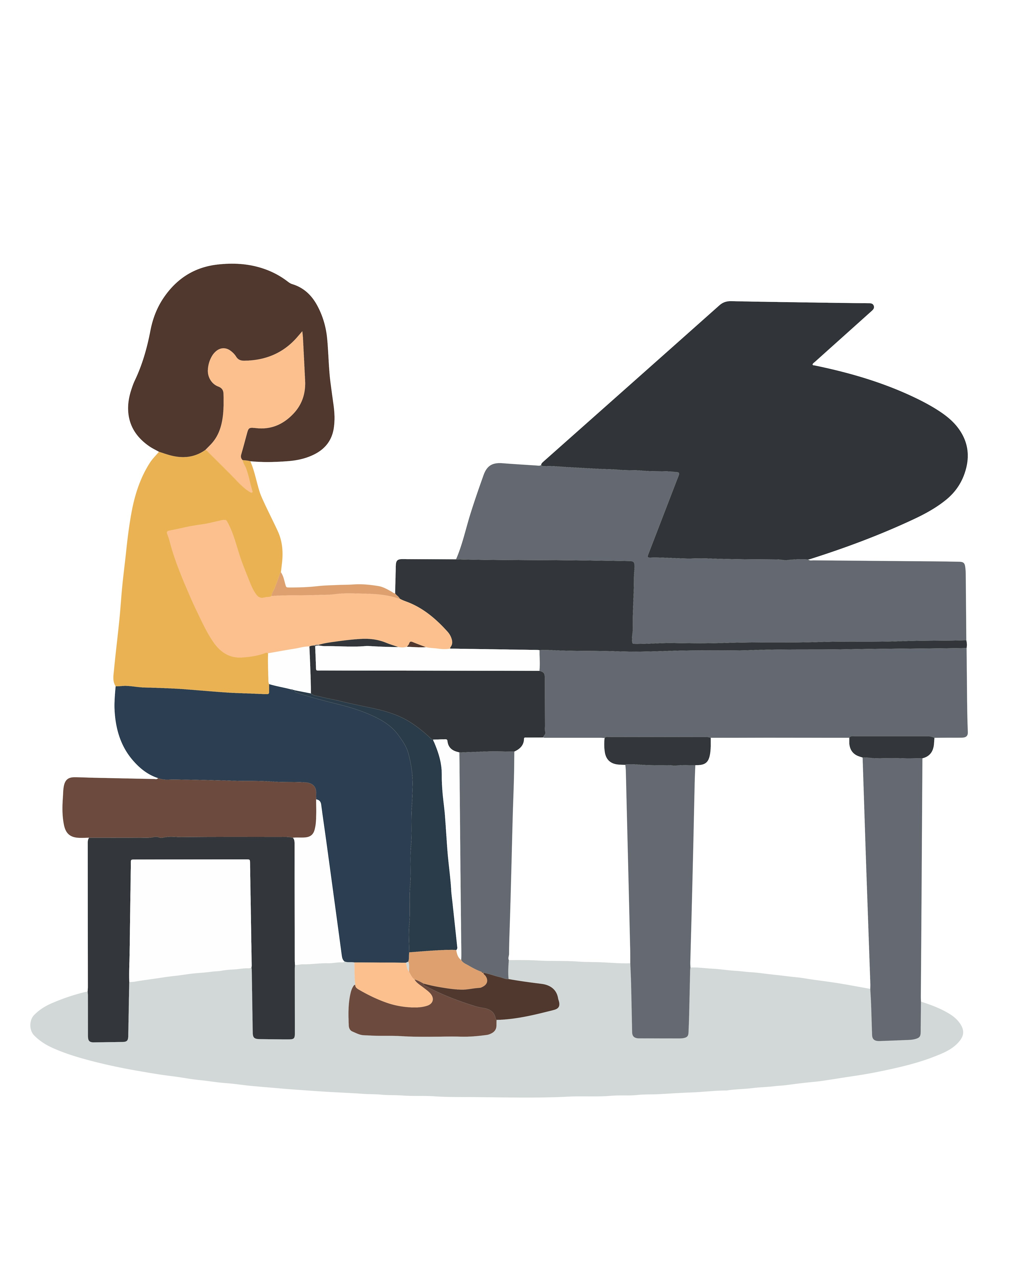
Talk to a Partner and Check Answers
4. Compare your answers with a partner.
5. Listen to the song and check your ideas.

Slide 15


Let’s Listen and Check the Answers
⭐
Why don't you tell me what you want
🔗 don’t-you
🔗 tell-me
🔗 what-you
⭐ whatyouwant
Nine to five in a nightmare, we're not scared
🔵 to → /tə/
🔗 five-in-a
🔗 in-a
🔗 we’re-not
⭐ werenotscared
⭐

Slide 16

Post-Listening Activity
Post-listening discussion questions:
Which words or phrases were hardest to hear clearly?
Did any words sound different than you expected?
Which phrase sounded like one long word?
Put students in pairs
Talk for 3-4 minutes

Slide 17

Post-Listening Activity
Speaking Practice
Practice saying this sentence:
Say it slowly, then naturally, then with rhythm.
  “I’ll tell you what you want to hear.”
  [I’ll tellyou whatchu wanna hear]

Slide 18
Today’s Agenda
Part 1: Reduced forms in music
Part 2: Building listening tasks
Part 3: Rhythm and stress instruction
Part 4: Mini-lesson demonstration

Slide 19

Scaffolding Listening Tasks
What is scaffolding?
• Teacher/material support that helps learners understand input
Why use it?
• Activates background knowledge
• Focuses on attention
• Builds confidence
• Makes authentic input accessible
Techniques
• Prediction
• Visuals
• Guiding questions
• Key words / partial scripts
Notes:
https://pixabay.com/photos/scaffold-scaffolding-construction-14253/

Slide 20

Scaffolding Listening Tasks
Procedure Roadmap
Pre-Listening:
    Prediction (Activates background knowledge, sets purpose, reduces anxiety)
While Listening:
1. First Listen – global (What’s happening? Main idea?)
2. Listen Again – details (Vocabulary, content, structure)
3. Comprehension Check (Quick validation through tasks (T/F, match, order, gap-fill, etc.)
Post-Listening:
    Speaking Practice (retell, summarize, opinion, personal connection, “what would you do?” prompts)
Notes:
https://pixabay.com/photos/scaffold-scaffolding-construction-14253/

Slide 21
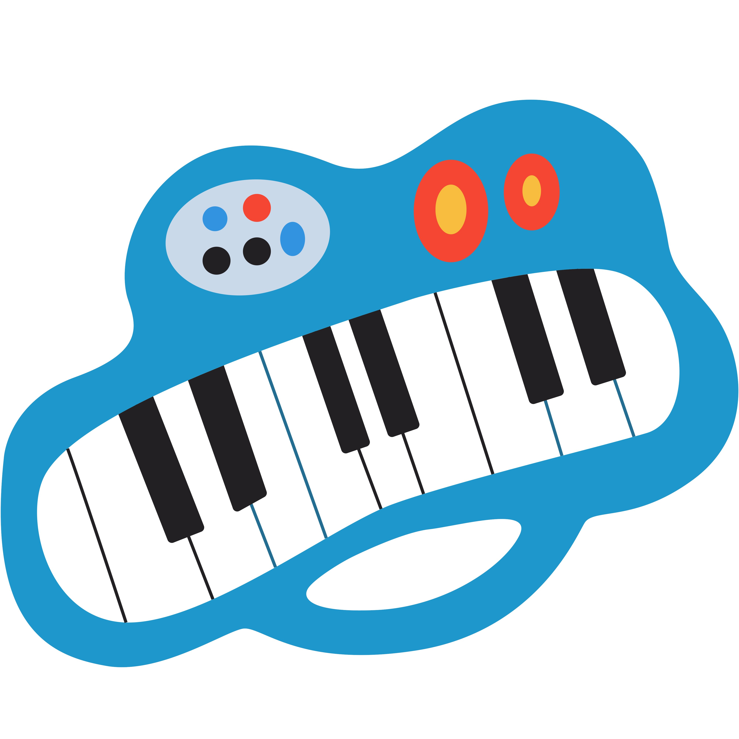
Your Turn!
Which scaffolding technique do you already use, and which one do you think you need to add or strengthen in your next listening lesson?

Slide 22

Tamara Jade: Better
New year, new me, new trees, new leaves Finally got the hang of this thing called life Taking it all in stride
On my own two feet,
traveling, living this dream
seeing places I ain’t never seen before
Ready for so much more
Here you come to mess things up for me, Walls are closing in on me,
It’s just all too much for me,
Stop, and breathe
Genre: Pop, Soul
Level: Intermediate-Advanced
Focus: Informal contractions and colloquial phrasing

Slide 23
Pre-Listening Task (prediction)
Look at the lines below. DO NOT listen yet.
Answer the questions:
1. What do you think “we gone” means?
2. Do you think this song will be slow or fast?
Tamara Jade: Better (Song Lyrics)
We gone, we gone, be alright
Keep your head up, it’s gonna get better

Slide 24

Listening Task 1: First Listen
Listen to the chorus.
Circle the words you hear
gonna gone going to we are going to

Slide 25

Listening Task 2: Listen Again
Listen again. Check (✓) the words you hear.
  ☐ going to
  ☐ gonna
  ☐ we are going to
  ☐ we gone
  ☐ be alright

Slide 26
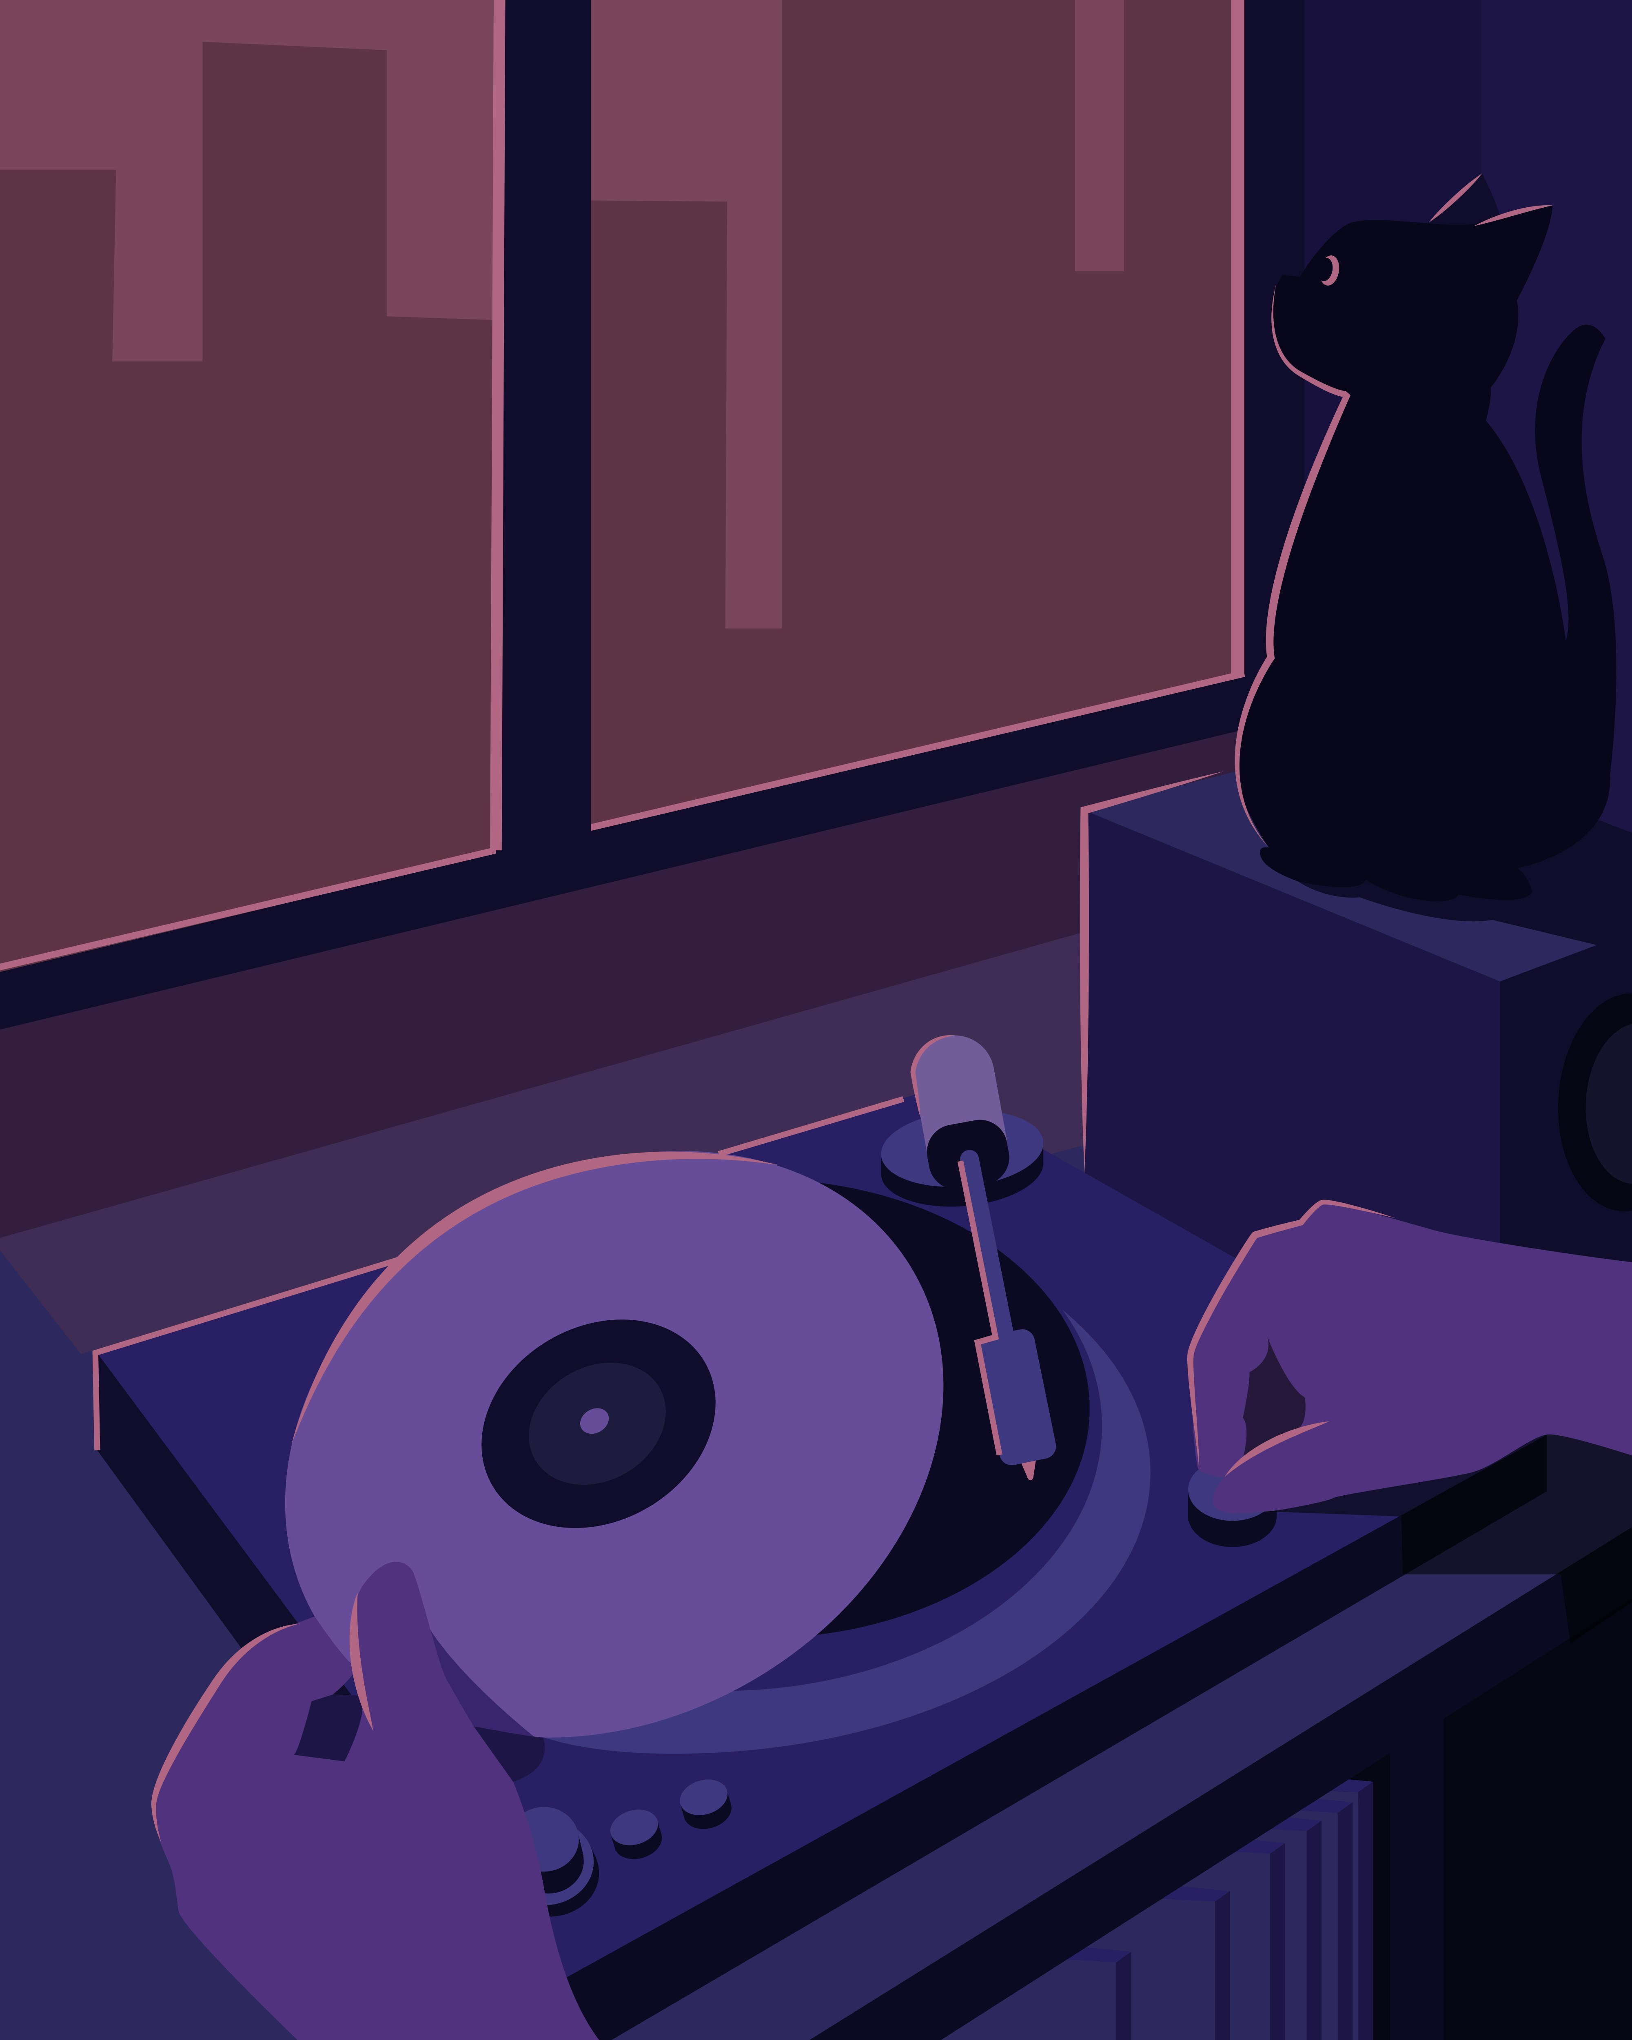
Meaning Check
What does “We gone be alright” mean in this song?
☐ Things will improve
☐ Things are finished
☐ Nothing will change

Slide 27
Post-Listening Speaking Practice
Practice saying the sentence below with your teacher:
Say it:
Slowly
Naturally
With rhythm
“We gone be alright.”

Slide 28
Today’s Agenda
Part 1: Reduced forms in music
Part 2: Building listening tasks
Part 3: Rhythm and stress instruction
Part 4: Mini-lesson demonstration

Slide 29

What is Rhythm and Stress?
Word stress = stronger syllable
→ reLAX, toDAY
Sentence stress = key words louder
→ “I WANT to GO”
Rhythm = beat from stressed peaks
→ YOU · got a · FRIEND · in · ME
→ I WAN·na HOLD · your HAND
Here the bold syllables = rhythmic “beats” and the dots = weaker fillers.
Why teach it.
→ helps listening, recognizing reductions + linking

Slide 30
Your Turn!
What do your learners typically notice first, meaning, rhythm, or stress? How can we shift their attention?

Slide 31

Tony Memmel and His Band:
I Am Never, Never, Never Gonna Give Up
In the heart there lives a call to a longer haul, A dream that demands your all.
It’s the hardest, clearest choice, when you hear its voice,
Step up and stand tall.
There’s an old and simple code you’ll learn as you go,
A truth the wise come to know:
You get out what you put in,
then come lose or win,
Sing this anthem of the soul:
I am never, never, never gonna give up. (repeated 6x)
Genre: Indie
Level: Intermediate-Advanced
Focus: Informal contractions and colloquial phrasing

Slide 32
Pre-Listening
Look at the line below. DO NOT listen yet.
1. Circle the words you think are STRONG (loud or long).
2. Underline the words you think are FAST or WEAK.
I am never, never, never gonna give up.

Slide 33
Listening Task 1
Listen to the line once. DO NOT speak.
Does this line sound smooth and musical?
Do some words sound faster than others?
I am never, never, never gonna give up.

Slide 34

Listening Task 2 – Shadowing:
Speak Together
Listen again and speak at the SAME TIME as the singer.
Do not stop if you miss a word.
How did it feel?
☐ Easy ☐ A little hard ☐ Very hard
Shadowing means speaking at the same time as the singer without stopping.
Conduct a Survey!

Slide 35

Listening Task 3
1. Whisper the Rhythm:
Listen again, and whisper the sentence.
Focus only on the rhythm and beat.
2. Tapping/clapping:
Tap or clap on the strong words if it helps.
3. Say It with Feeling
Now say the line with confidence and emotion.
Use a strong voice and body language.

Slide 36
Post Listening-Speaking Activity
Complete and say the sentences below using natural rhythm:
Sample Answers
1. This year, I’m never gonna ___________________________.
2. When things are difficult, I’m never gonna ______________.
1. This year, I’m never gonna eat too much junk food.
2. When things are difficult, I’m never gonna quit.

Slide 37
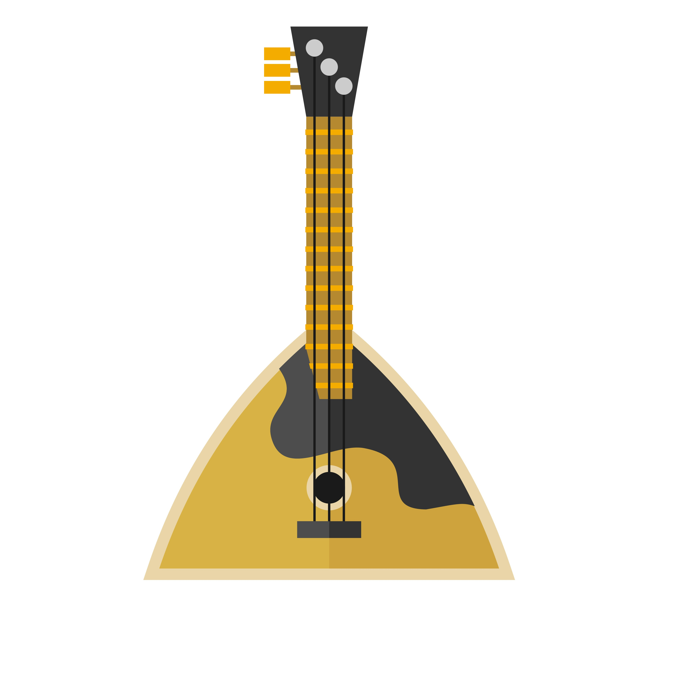
Your Turn!
How do you bring rhythm into your lessons in a way that keeps learners engaged? Share one activity or approach that works well for you.

Slide 38
Today’s Agenda
Part 1: Reduced forms in music
Part 2: Building listening tasks
Part 3: Rhythm and stress instruction
Part 4: Mini-lesson demonstration

Slide 39
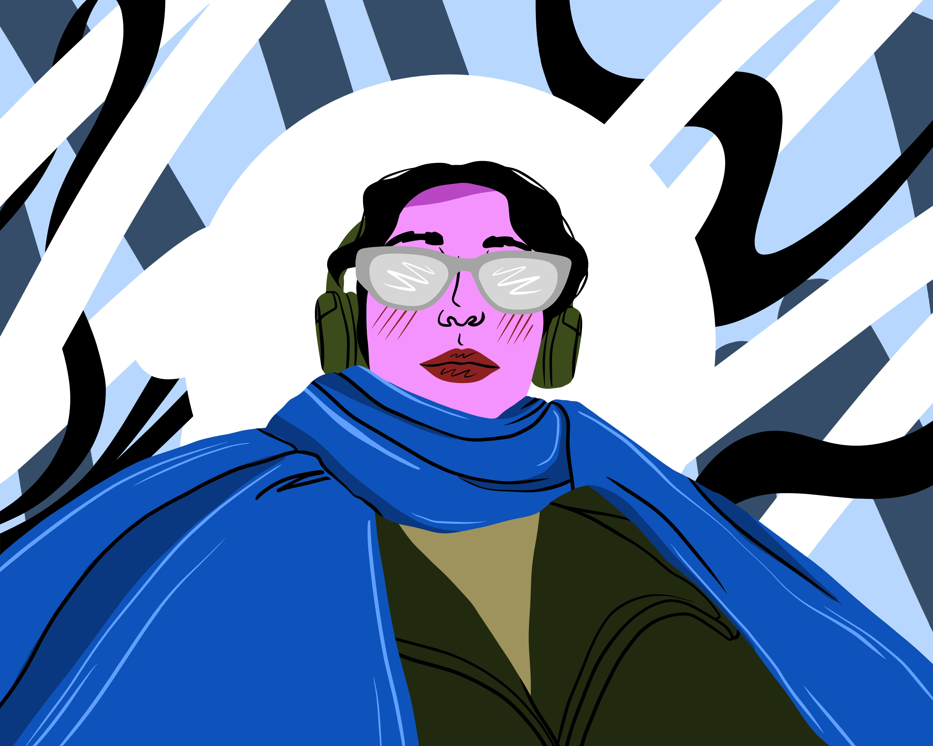
Jessica Lynn: Run To
I can't just quiet my mind
It talks all the time now
Figuring us out
Where do we go?
All of the questions at hand
They feel like quick sand how
They're pulling me so down
But I'd never show, that I already know…
I wanna run to
Anything that makes me feel you
I'm tryin' my best,
What would lying do?
I've lied to myself for so long
Genre: Country, Pop, Rock
Level: Intermediate
Focus: Reduced forms, contractions, emotional intonation

Slide 40

Mini Lesson Steps
Warm-up
Lyric preview
Listening
Pronunciation
Reflection

Slide 41
Choose a Pronunciation Target
Pronunciation Target Examples
Reductions
wanna, tryin’
Contractions
I’ve, I’m, I’d
Intonation
emotional rise/fall in personal statements

Slide 42

Step 1: Warm-Up
Student Prompt – Think & Share:
When you feel confused, sad, or emotional…
Who or what do you want to run to?
A person
A place
Being alone
Music

Slide 43

Step 2: Lyrics Preview
Show ONLY these lines:
Teacher prompts:
What do you notice about these words?
Do they look formal or informal?
What do you think wanna means?
I wanna run to
I’m tryin’ my best
I’ve lied to myself for so long

Slide 44

Step 3: 1st Listen
Listen and check what you hear:
☐ I want to
☐ I wanna
☐ I am trying
☐ I’m tryin’
☐ I have lied
☐ I’ve lied
(Play 30–40 seconds of the song)

Slide 45
Step 4: Focus on Pronunciation
Model on slide:
Full form → Natural form
I want to → I wanna
I am trying → I’m tryin’
I have lied → I’ve lied
Choral Practice:
Say it slowly
Say it naturally
Say it with emotion

Slide 46
Step 5: Post Listening Reflection
Student reflection (choose one):
Students share with a partner.
When I feel overwhelmed, I wanna run to __________.
I’ve told myself __________ for a long time.

Slide 47
Takeaways
What teachers should notice:
✔ Clear pronunciation target
✔ Short, scaffolded listening
✔ Minimal explanation
✔ Emotional engagement
✔ Speaking at the end

Slide 48

Your Turn!
Thinking about your own classes, which of these Mini Lesson components do you already use, and which one would you like to integrate more intentionally?
Mini Lesson Steps:
Warm-up, lyric preview, listening, pronunciation, reflection

Slide 49
In This session, We Learned How…
music supports real-world listening and pronunciation
small, focused tasks train the ear
rhythm-first speaking builds fluency

Slide 50
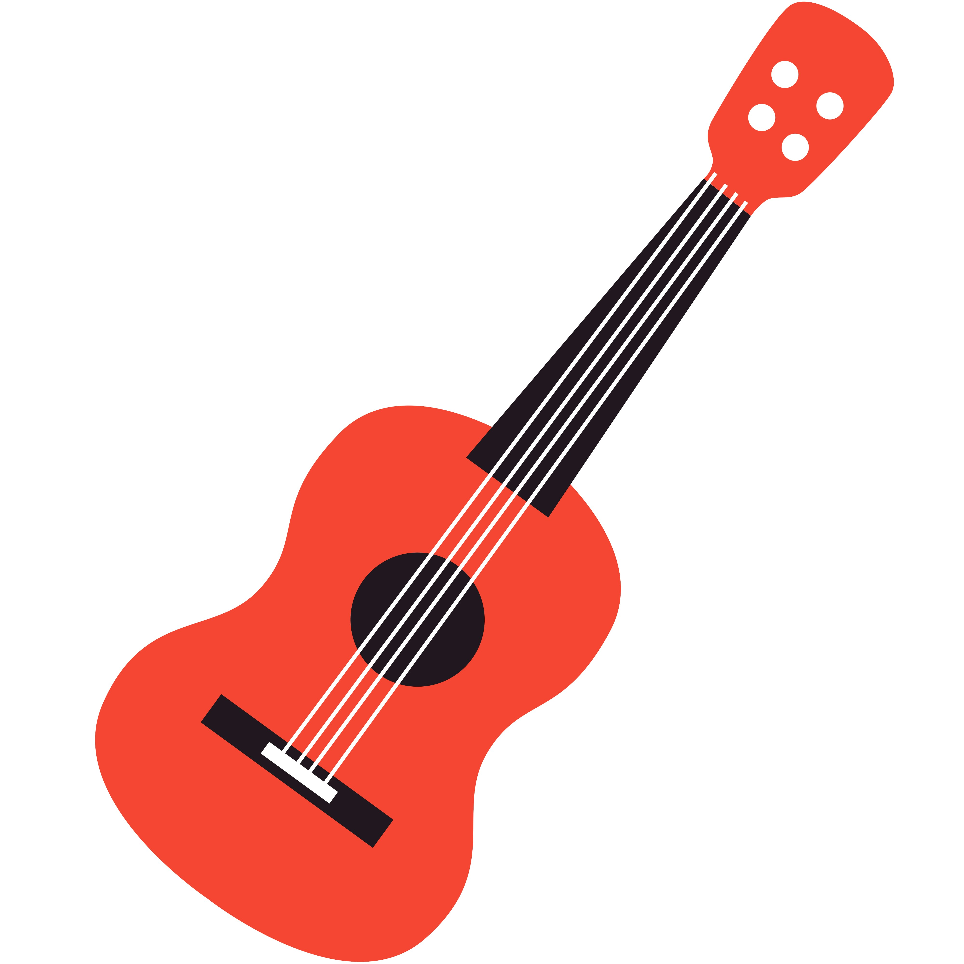
Reflection: Your Classroom
What’s one small change you can make tomorrow to support pronunciation through music?

Slide 51
References
American English. (n.d.). English language through lyrics. U.S. Department of State. https://americanenglish.state.gov/resources/english-language-through-lyrics
Unless otherwise noted, all images in this presentation are the author’s own or are “no-attribution required” under the Pixabay simplified license, Unsplash license, or Pexels license.

